Slide 1
A Scalable Internet Architecture
Nirmala Shenoy, Victor Perotti,
Rochester Institute of Technology (RIT)
Technical and socioeconomic studies
Koushik Kar, Aparna Gupta
Rensselaer Polytechnic Institute (RPI)
Technical and business studies
Murat Yuksel
University of Nevada, Reno (UNR)
Technical studies

Slide 2
Technical Questions
Addressing
Do we need 2 addresses? Logical and Physical
Observation – global Logical addresses - look up and extensive routing
32 not enough, 128 not wireless friendly
Flexible - tailored to requirement, easy transition
Current Internet – optimize on meshing
When to mesh and how much?
Combination of hierarchy and mesh structures
Given above- relook at the protocol stack?
Topological consideration
Protocols
The above should be ISP friendly. Easy transition

Slide 3
Architectural studies
Addressing
Structural topology
Wireless networks support

Slide 4
Addressing in the ISP topology
High level
Typical -
Tier 1
BB1
BB2
One POP
BB3
CLOUD
CLOUD
CLOUD
Tier 2
DR1
DR4
DR2
DR3
Tier 3
AR1
AR2
AR4
AR3
RIT
RPI
UofN

Slide 5
Tier based addressing - inter and intra cloud
BB cloud identifier
Tier 1prefix
1.
1
1.1:1
BB1
BB3
2.1:2:x
1.1:3
BB Cloud identifier
DR cloud identifier
1.1:2
BB2
2.1:1:1
DR1
DR4
Tier 2 prefix
2.
1:
1
DR2
DR3
2.1:1:4
2.1:1:2
2.1:1:3
AR1
AR3
AR3
AR4
Tier 3 prefix 3.
1:
1:
1
3.1:1:1:1
3.1:1:1:2
3.1:1:1:3
3.1:1:1:4
Rochester Institute of Technology
Rensselaer Polytechnic Institute
Tier 4 prefix 4.
1:1:1:1??
Flexible Addressing - Wireless friendly

Slide 6
Flexibile Addressing Scheme
Tier field
Length field
Address field
Length field
Address field
6 bits
2 bits
4- 12 bits
“01”
“10”
“11”
“00” → Special handling
4 bits → 16 systems
8 bits → 256 systems
12 bits → 4096 systems
6 bits – 64 tiers
2.1:1:4
000010 01 0001 01 0001 01 0100
tier 1st address 2nd address 3rd address

Slide 7
Flexibility in Addressing Scheme
Faster forwarding between tiers –
Switch on tier field – UP, DOWN,
Same level –Mesh as required and route - maximum 4096
Distribute routing load to within tiers
Address length depends on tier level – (no fixed size)
Addresses will never run out
00 - Special addressing – wireless networks, roaming user
Flexibility – nested addressing

Slide 8
Nested Addressing
DNS
BB1
BB2
Cloud ID 1.1
BB3
Cloud ID– 2.1:1
DNS
DR1
DR4
DR2
DR3
Cloud ID– 3.1:1:1
AR4
AR3
Global ID– 3.1:1:1:x
Flexibility at tier level
Internal addressing structure
Private, partly private/public
DNS to locate
DNS hierarchy
domain name service /tier
BB2
Tier 1 – 1.1
BB1
OR1
OR2
Tier 2 – 2.1:1
Client network
Small ISP
DNS

Slide 9
Special Handling
Length field = 00 – No forwarding
Address field
00 – Last address field
01 - Roaming user
02 - Proprietary addressing
IPv4
IPv6?
03 – sensor networks
04 – user requires an address
05 – user requires some service
Length field
2 bits
01 – 4 bits
10 – 8 bits
11- 12 bits
00- special handling

Slide 10
Roaming User
AAA server
Cloud ID 1.1
BB1
BB2
BB3
AAA server
AAA server
Cloud ID– 2.1:1
DR1
DR4
Cloud ID– 2.1:2
DR2
DR3
AR1
Cloud ID– 3.1:1:1
AR2
AR4
Cloud ID– 3.1:2:1
3.1:1:1:2
3.1:1:1:1
3.1:2:1:4
Request – length=00, Afield=01
Request – length=00, Afield=01
TIER LEVEL DISTRIBUTED AAA SERVERs
MN
MN
Address assigned – 3.1:1:1:1:x
Address assigned – 3.1:1:1:2:x
NO HOME ADDRESS CONCEPT – LOCATE BY NAME SERVICE ONLY

Slide 11
The Protocol Stack
Application with reliable transmission if required
Max routing table size -4096
Tier 1 ISPs - around 10 entries
Impact on all optical networks
Inter ISP agreements (RPI &UNR)
ISP - transit services (RPI & UNR)
Port Services
Switch up/down,
Intra-tier routing
Medium Access control
Physical layer

Slide 12
Socioeconomic and Business Impact studies

Slide 13
The Socioeconomic Piece: Towards Understanding the Market Context for Network Innovation
Initial Business Industry Analysis
Buyer Power
Language check: Deployment ≠ Adoption

Slide 14
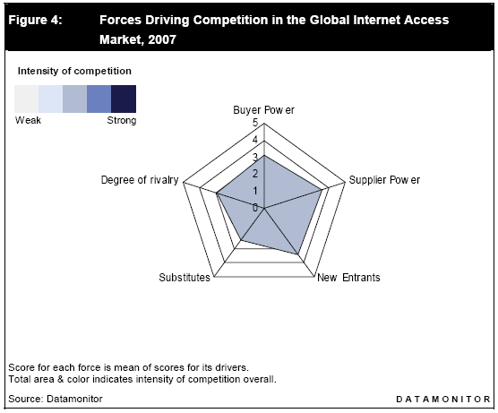
Which forces are prevalent in the Internet Industry?
Traditional Business Analysis (ala Porter) looks at 5 Forces in an Industry.
Collectively, these forces inform the business opportunities available in this Industry
Note: The threat of New Entrants and Supplier Power are the key Drivers according to Datamonitor 2007

Slide 15
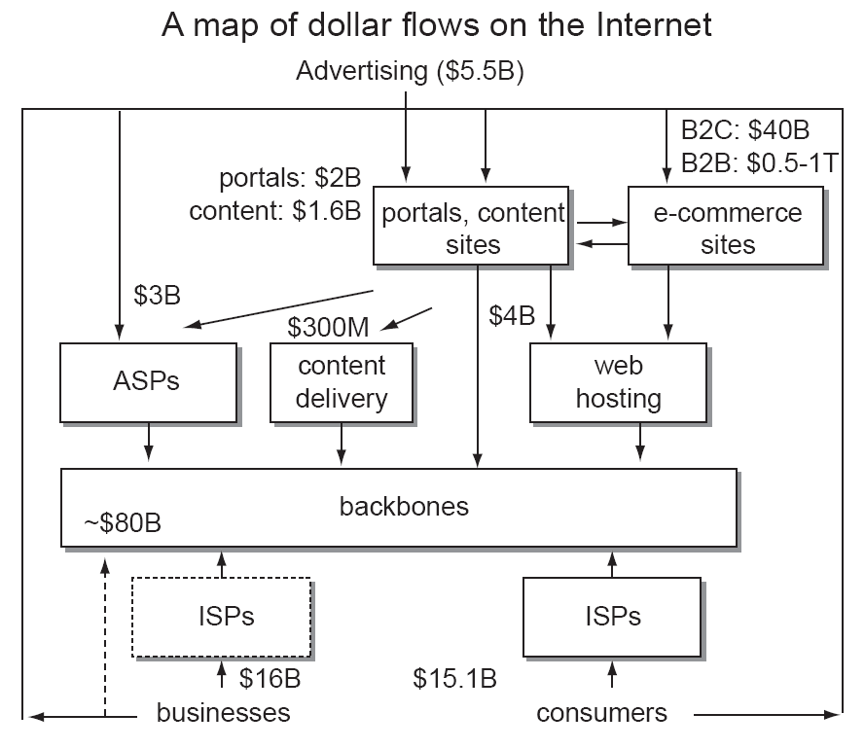
Which entities are capturing value?
Shawn O'Donnell’s 2002 Economic Map of the Internet is being enhanced to reflect the state of the 2009 Internet Industry.
An Economic Value Map can help to identify key influencers in the Industry.

Slide 16
But what else is happening?
“Web could collapse as video demand soars” –Daily Telegraph 4/28/2008
“Study: 44% Of Internet Traffic Is Peer-to-Peer” Multichannel News 6/23/2008
“NebuAd loses CEO, business model in wake of tracking furor” Ars Technica 12/5/2008
susanbeebe RT @Dan_Agnew: RT @LeeDrake: I am putting together a website to try to attract VerizonFIOS to Rochester. #TWC needs some real competition about 8 hours ago from TweetDeck

Slide 17
Traditional analysis does not capture the new importance of users
Scott Jordan’s 4 Tenets
ISP adoption driven by consumer “product” (example VOIP or Video)
Fixing problems versus enabling features
“Glacial” adoption of IPv6
Science Engineering Economics Business Here Be Dragons

Slide 18
And further
Clemon’s concept of Informedness alters traditional thinking on Product, Promotion, Pricing(2008).
How might we designing “Products” and/or Incentives for various target Customers (ISP, CIO, End User)
Contract Switching…coming up next

Slide 19
Questions ?

